Slide 1
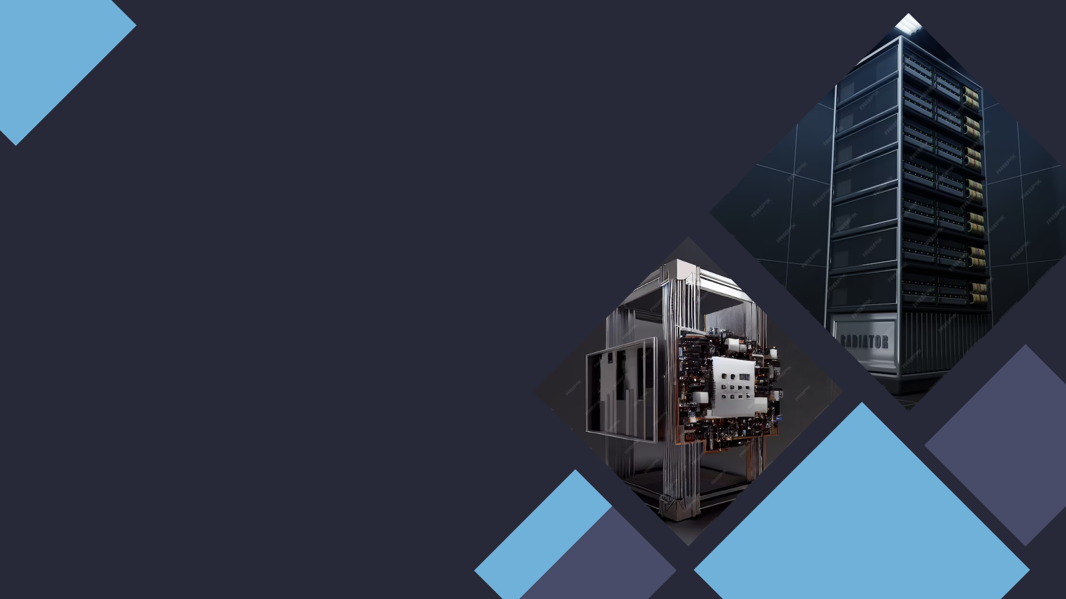
Created by Ciobanu Stanislav
Server vs Terminal

Slide 2

What are the servers and terminals
Server is a computer or software system that provides services, resources, or data to other computers, known as clients
Terminal, or client, is a device or software that interacts with a server to access the services and resources it provides.

Slide 3
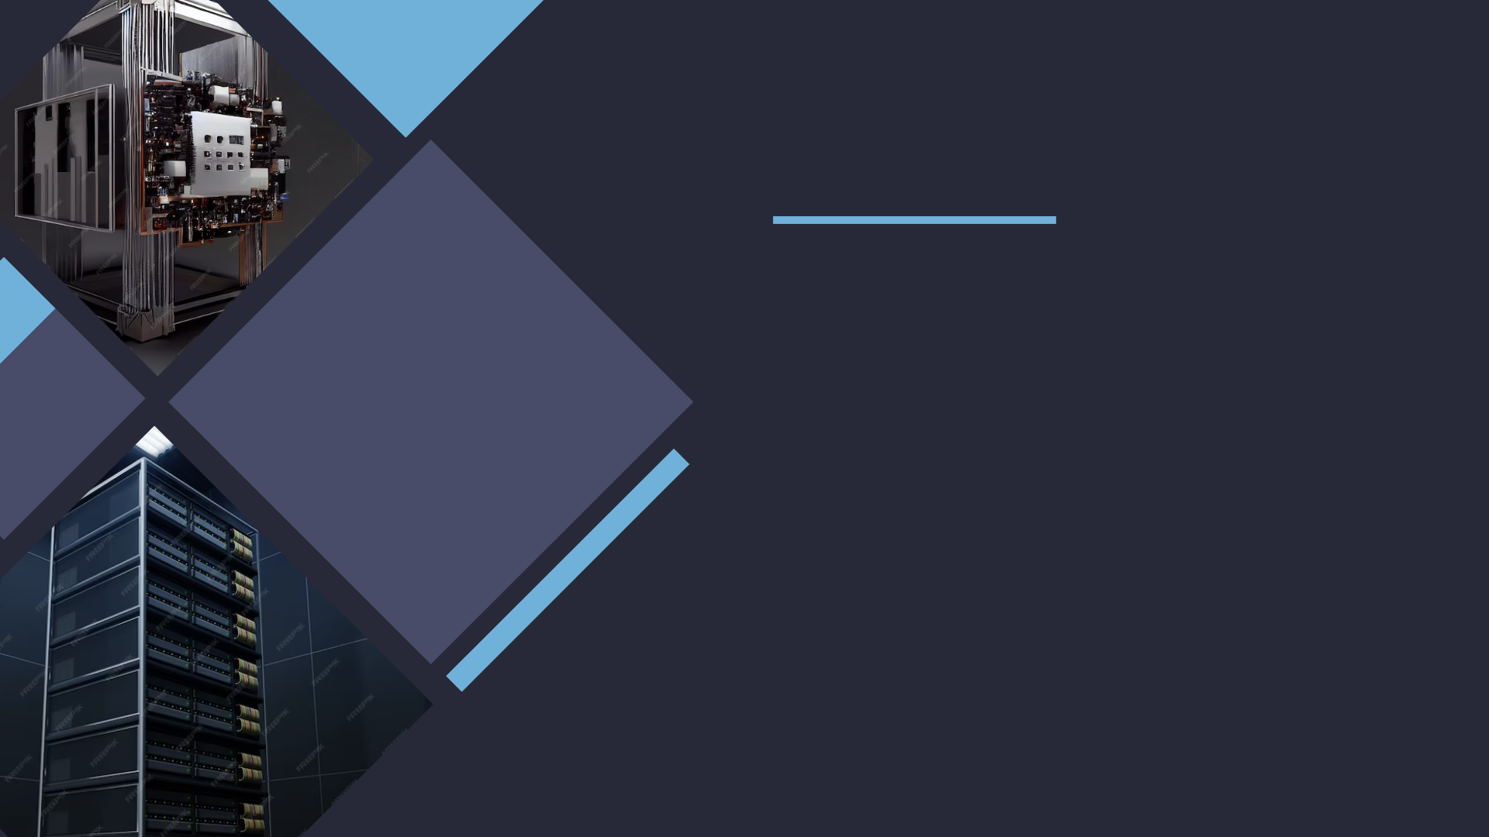
Roles and functions
Servers:
Primary role is to serve and provide resources.
Perform tasks like data storage, processing, and hosting websites or applications.

Slide 4
Hardware and Networking
Servers:
High-end, powerful hardware.
Multiple CPUs, large storage, extensive RAM, and redundant components.
Specialized server operating systems.
Terminals:
Varied hardware, based on user needs.
Laptops, desktops, tablets, and smartphones come in various configurations.
General-purpose operating systems (e.g., Windows, macOS, Linux).
Run applications and access server resources.

Slide 5
Location
Servers:
Typically are located in data centers or other remote locations.
Are designed for stabile working 24/7.
Terminals:
Usually found on user’s desks or in their hands (smartphones, laptops and e.t.c).
Designed for portable and easy use.

Slide 6

Cooperation
Servers maintain work of many terminals.
Client-server model is based on multiple terminals, that reflect individual clients.
Servers also differ with their ranks and specializations. One client can be serviced by some servers, that complete different tasks.

Slide 7
Conclusions
Understanding the distinctions between servers and terminals is essential in modern computing.
Servers provide resources and services, while terminals consume them.
Both play critical roles in the digital ecosystem.

